Slide 1
Overview of Global Container Management Programs
The Pesticide Stewardship Alliance Conference
Mobile, AL
February 7, 2013

Slide 2
Discussion Outline:
CropLife International - Container Management Committee
Overview of national CMP’s
Mature Programs
Developing Programs
Design Phase
Issues, trends and future observations

Slide 3
CropLife International – CMP Committee
Vision: To have a safe and responsible management of empty, properly rinsed pesticide containers worldwide, with our industry recognized as a leader for this initiative
Impact measurement: KPI’s
Countries with programs
Volumes recovered/recycled
Program cost
No health, safety or environmental issues
Continuous improvement

Slide 4
Collection Programs 2012
Status per continent
Africa/ Middle East
Botswana
Cameroon
Ghana
Kenya
Madagascar
Malawi
Namibia
South Africa
Swaziland
Uganda
Asia/ Pacific
Australia
Bangladesh
China
India
Indonesia
Japan
Korea
Malaysia
New Zealand
Sri Lanka
Thailand
Europe
Austria | Luxemburg
Belgium | Poland
Bulgaria | Portugal
Croatia | Romania
Czech Rep. | Russia
Eire | Slovakia
France | Slovenia
Germany | Spain
Greece | The Netherlands
Hungry | Turkey
Kazakhstan | Ukraine
Latvia | Uzbekistan
Lithuania | UK
North America
Canada
USA
Latin America
Argentina | Guatemala
Bolivia | Honduras
Brazil | Mexico
Chile | Nicaragua
Colombia | Panama
Costa Rica | Paraguay
Dom Republic | Peru
Ecuador | Uruguay
El Salvador | Venezuela

Slide 5
Estimated Packaging Mass (Global)
as of 2012
13,000 tons
34,000 tons
80,000 tons
30,000 tons
63,000 tons
Total: 220,000 tons
slide 5

Slide 6
Packaging collected (tonnes, rigid
plastic) with pilots
Africa/ME (pilots)
Year
slide 6

Slide 7
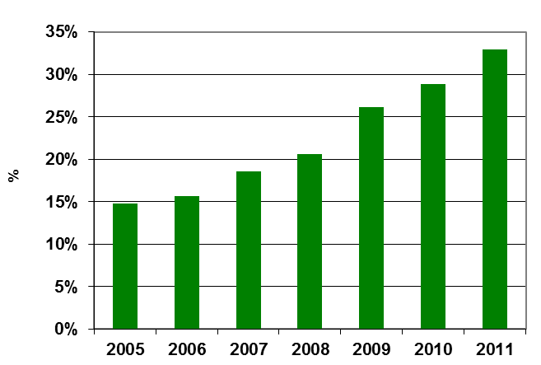
Percentage Recovered
(Reference: 220,000 Tonnes)
All countries (incl. pilots)
Year
slide 7

Slide 8
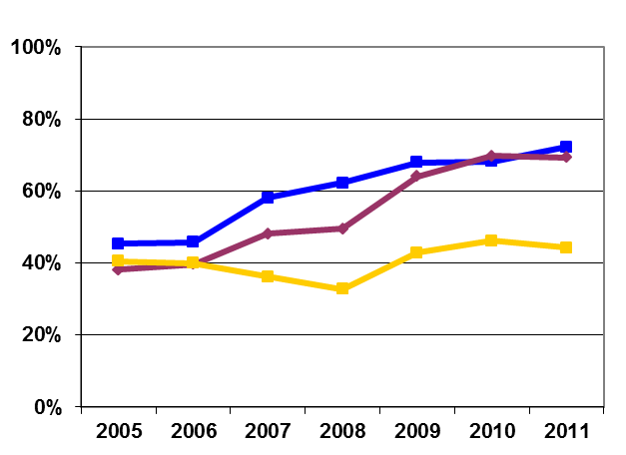
Recovery rates per region
Year
slide 8

Slide 9
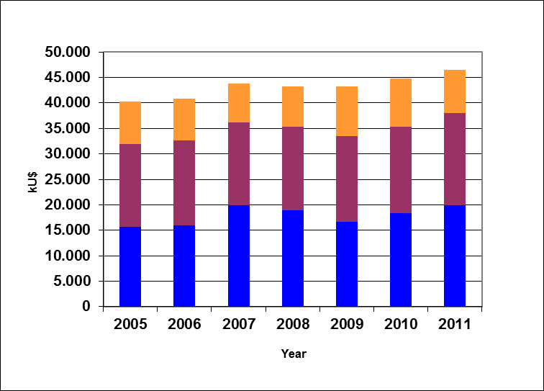
Total cost of programme (global,
US$ million)
Year
slide 9

Slide 10
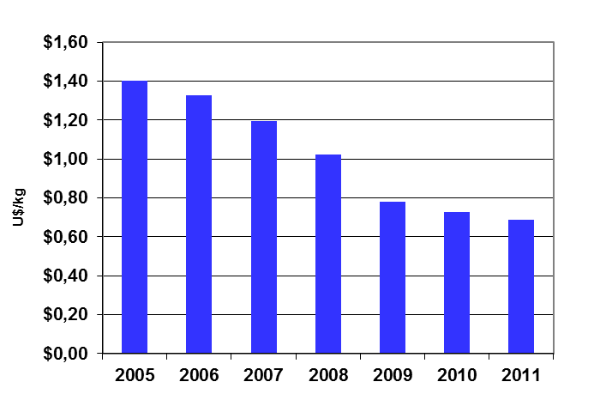
Cost per kg collected
(US$/kg)
Year
slide 10

Slide 11
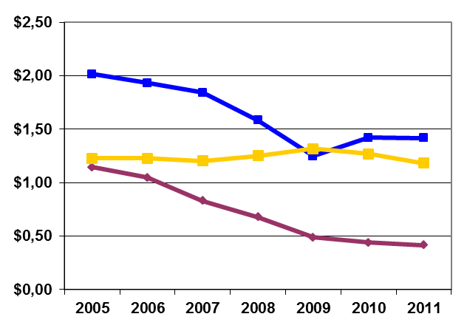
Cost per region
(US$/kg recovered)
Year
slide 11

Slide 12
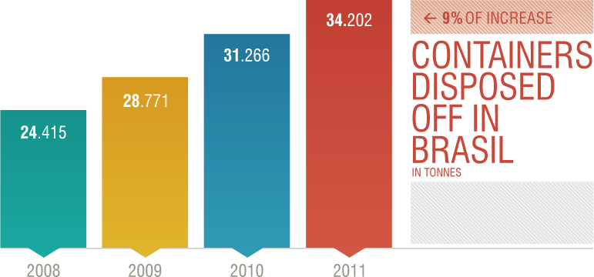

Slide 13
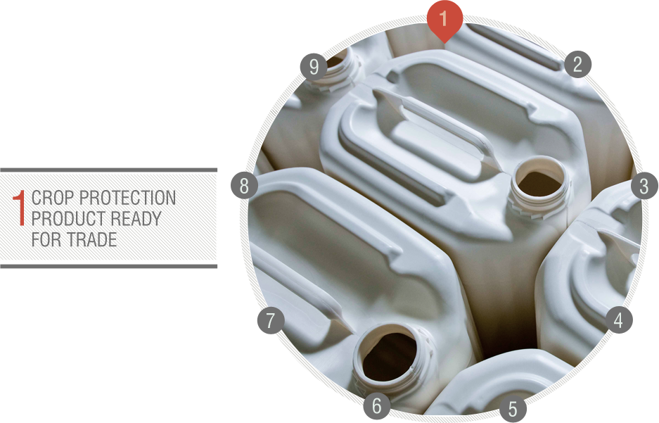

Slide 14
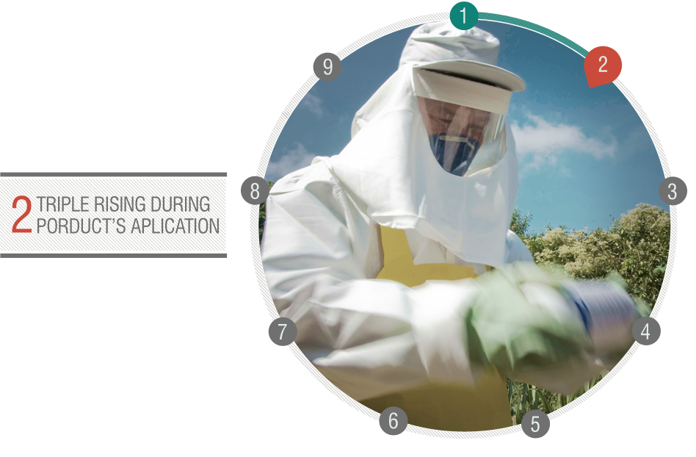

Slide 15
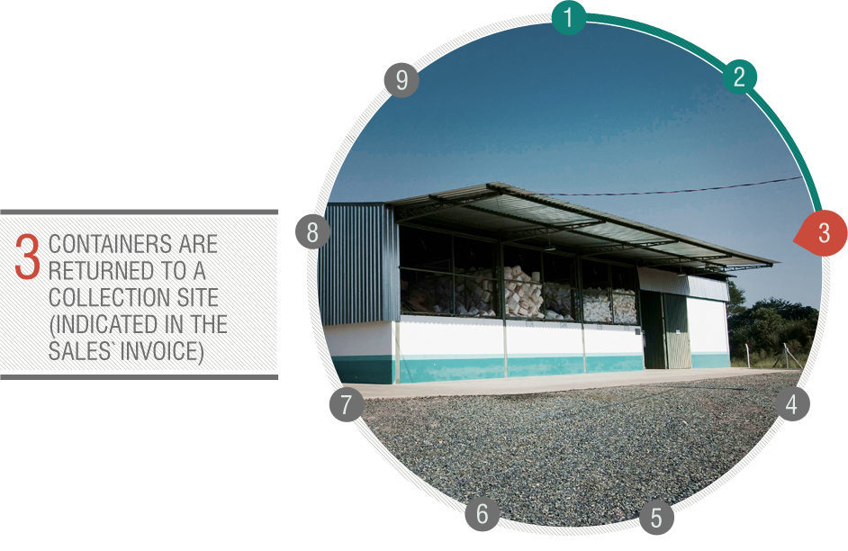

Slide 16
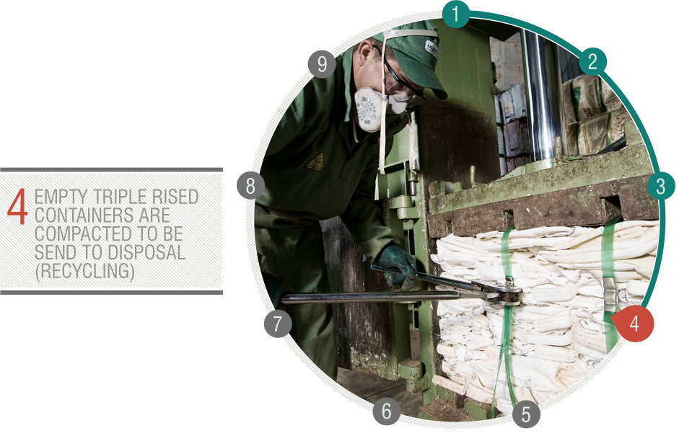

Slide 17
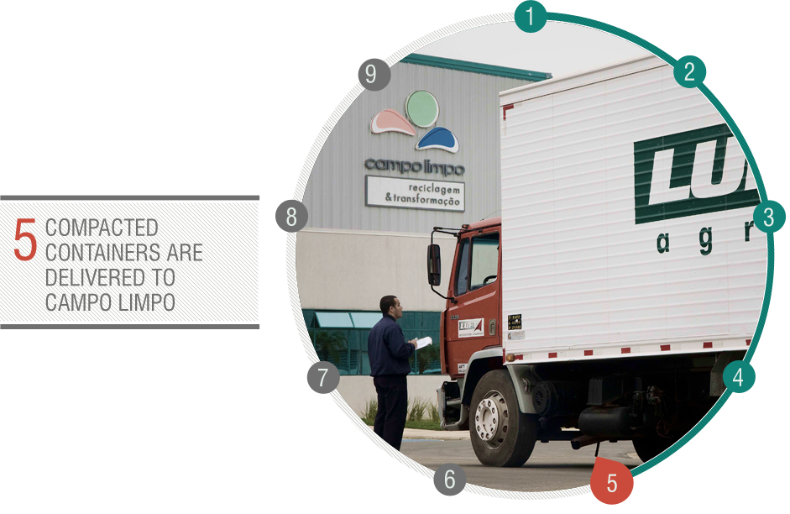

Slide 18
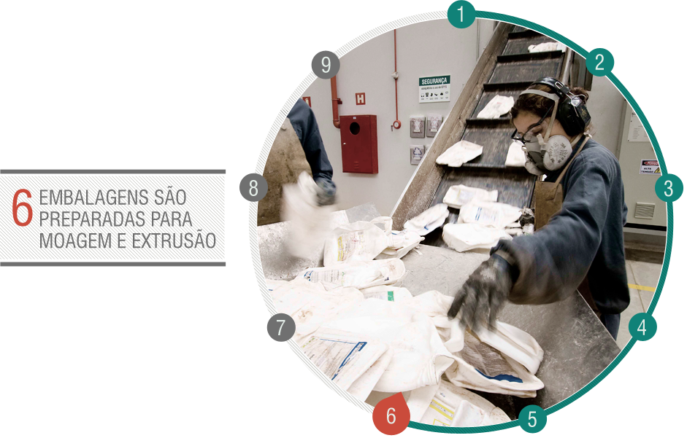

Slide 19
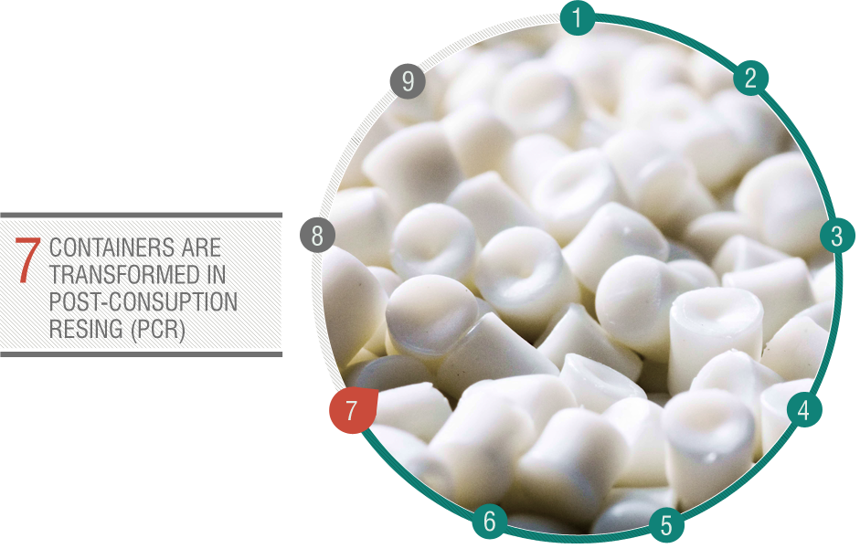

Slide 20
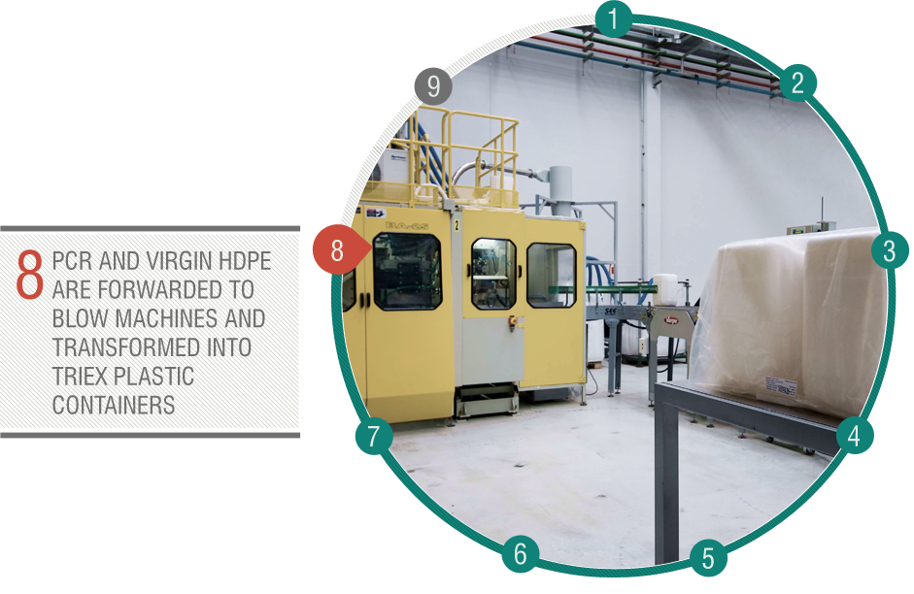

Slide 21
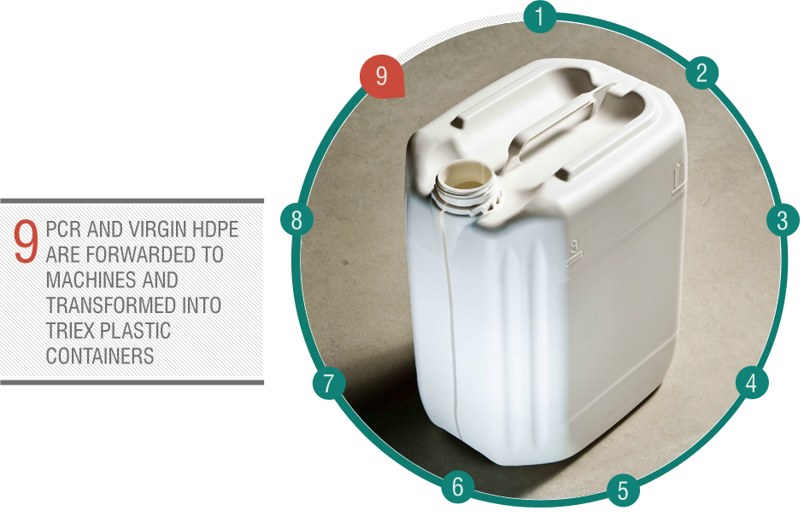

Slide 33
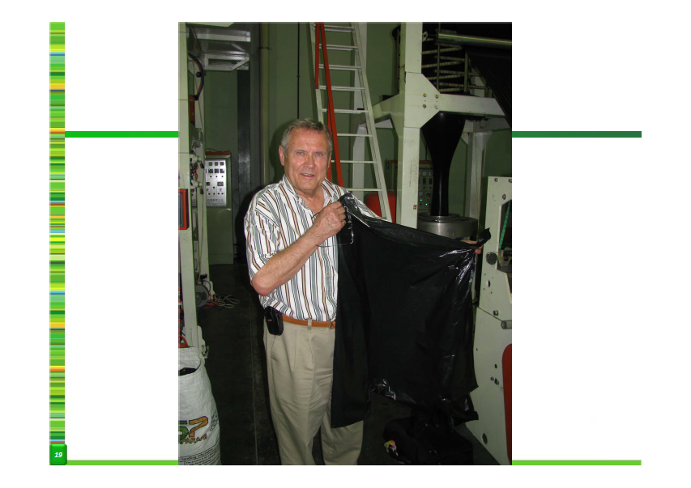

Slide 34
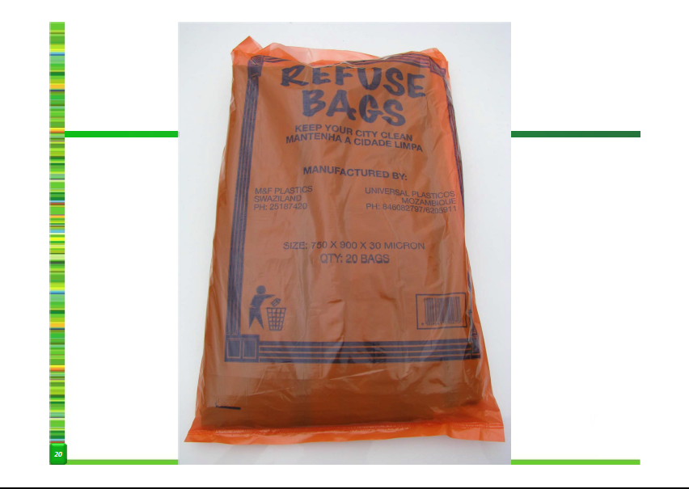

Slide 36
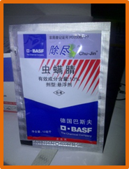
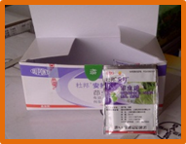
Background
Very popular in China, (some in other countries too)
Usually contain 5 to 25 ml of liquids
Providing a single dose
Advantages of small sachets:
Low in cost
Reduce confusion over dosage
Do not require on-farm pesticide storage
Solids are also in Sachets, but are of less concern

Slide 37
Quick Facts
> 500 million liquid sachets are sold in China each year
Both liquid pesticides and fertilizers are available in sachets.
This is the most popular packaging for small farmers
Most sachets contain at least 0.5 ml after emptying

Slide 38
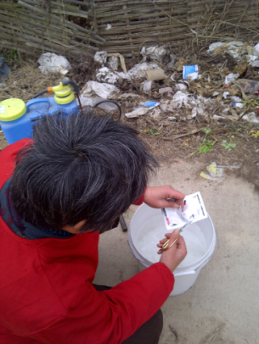
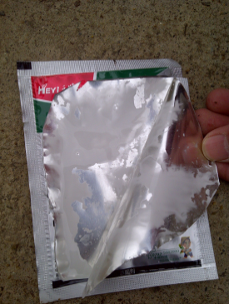
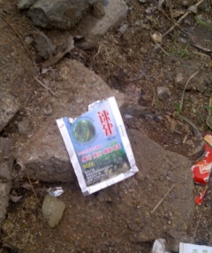
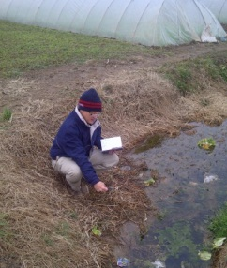
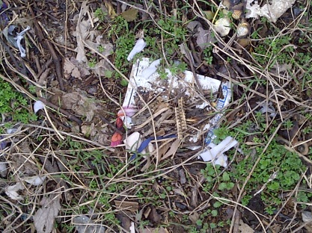
Areas of Concern
Potential exposure during opening and mixing
The habit of discarding empty sachets in the field
Residual material left after emptying sachet
Do not rinse sachets
residue inside sachet
Discarded into field
Discarded into ditch
0.5ml left * 500 million sachets = 2.5 million liters of waste
For a 5 ml sachet , leaving half a ml in the sachet after emptying means that the target dosage will be off by 10%
Still there after years gone by

Slide 39
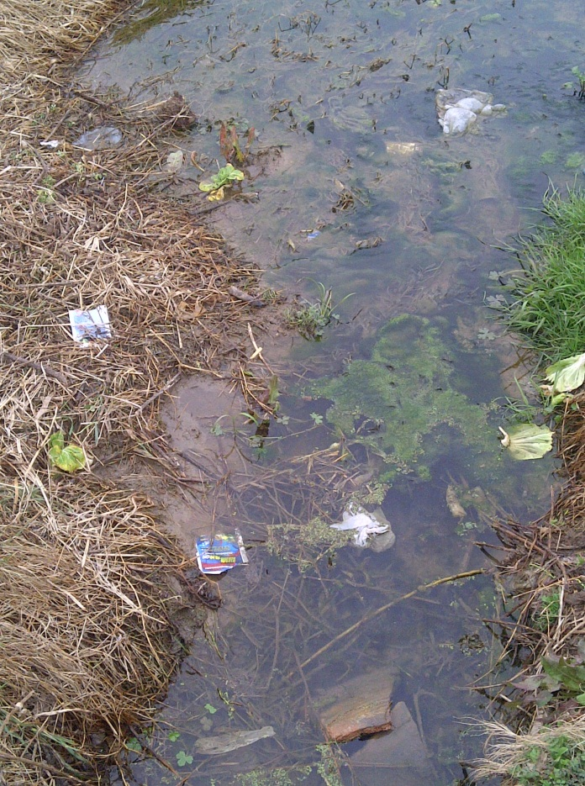
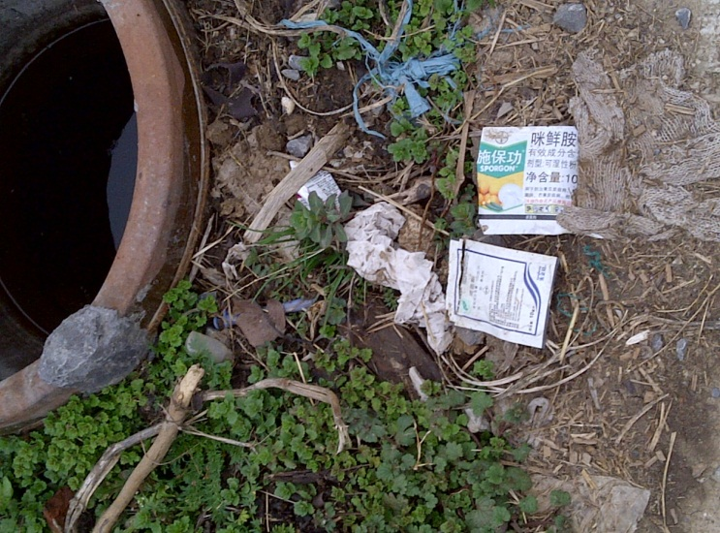
Sachet Disposal – A Critical Issue
Need an expert-Industry direction
How to deal with contaminated sachets?
Every 2000 empty sachets (= 40 cartons) may contain about 1 Liter of leftover pesticide

Slide 40
Issues, Trends & Future Observations
Risk Reduction
Improving rinse rates
Recycled product end user assurance process
New product EH&S testing
Improved Collection Rates
User awareness
Accessibility

Slide 41
Issues, Trends & Future Observations
Program efficiencies
Collection sites/dates/partners
Free riders
Recycling vs energy recovery
Product pooling
Adding value to recycled materials
Additional complimentary waste streams
ISO/QM certification

Slide 42
Issues, Trends & Future Observations
Government Involvement
Help or hindrance?
Role of federal, provincial/state & municipal

Slide 43
Questions?
Russel Hurst
CleanFARMS
hurstr@cleanfarms.ca

